Slide 1
Respiration

Slide 2
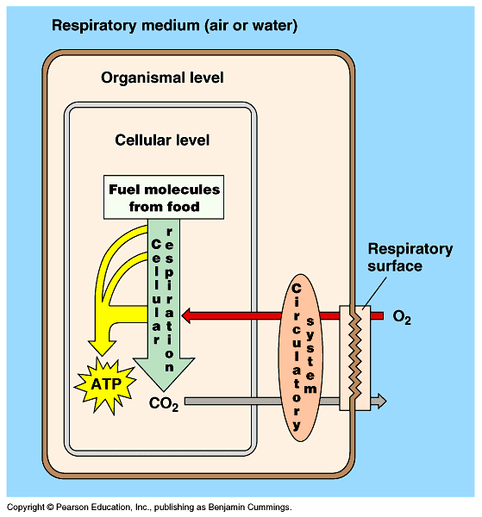
Respiration and the role of gas exchange in bioenergetics
Notes:
Goal is to get O2 into the cell where it can be used to produce energy through cellular respiration

Slide 3
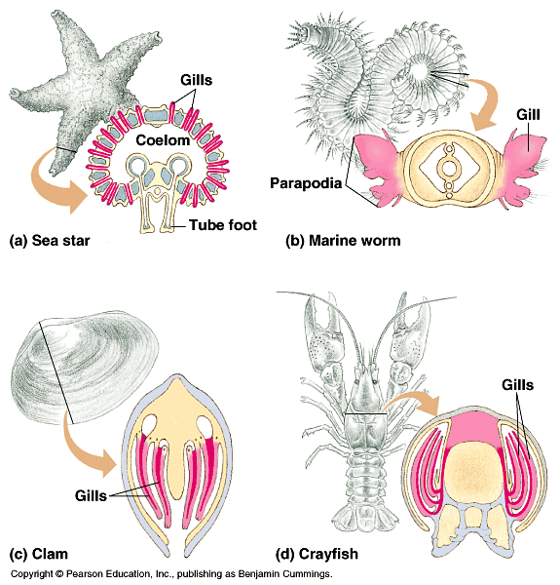
Gas exchange occurs across a variety of surfaces
Notes:
Different structures depending on how much oxygen it needs (more surface area is achieved by larger surface area)

Slide 4
A number of organs – e.g. skin, gills, lungs - can serve as gas exchange surface
Lots of animals exchange a lot of gas through their skin
Higher metabolic rates = higher gas exchange surface areas

Slide 5
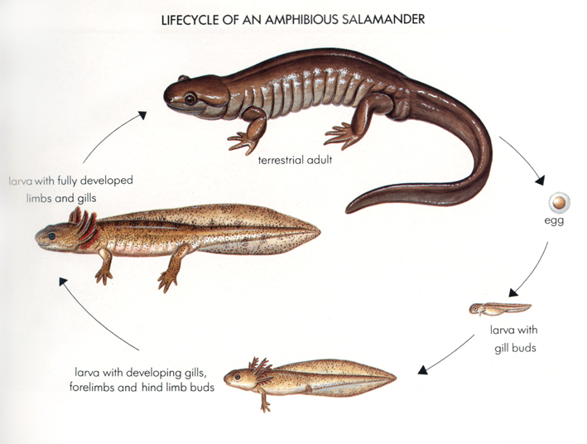
A particular kind of animal can have more than one gas exchange surface

Slide 6
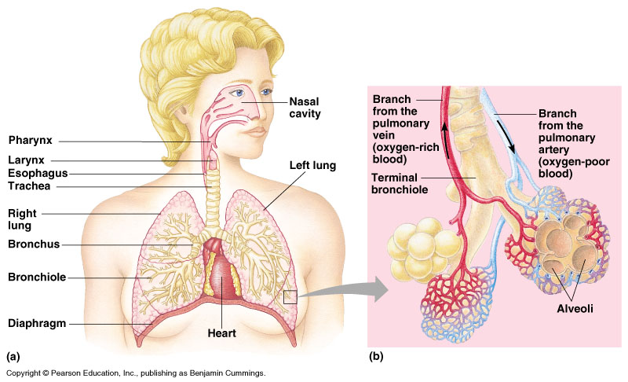
Internal lungs provide surface area and resist desiccation

Slide 7
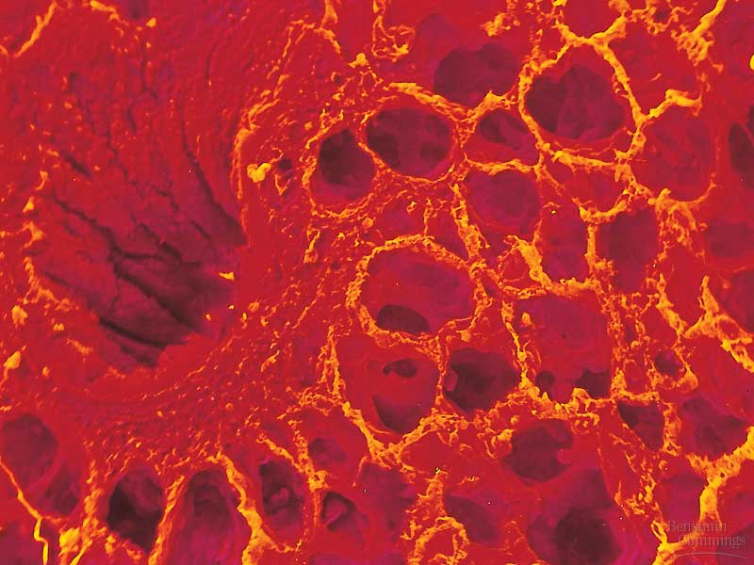
Alveoli

Slide 8
Step 2: Ventilation puts the external medium in contact with the respiratory exchange surface
Notes:
See next few slides

Slide 9
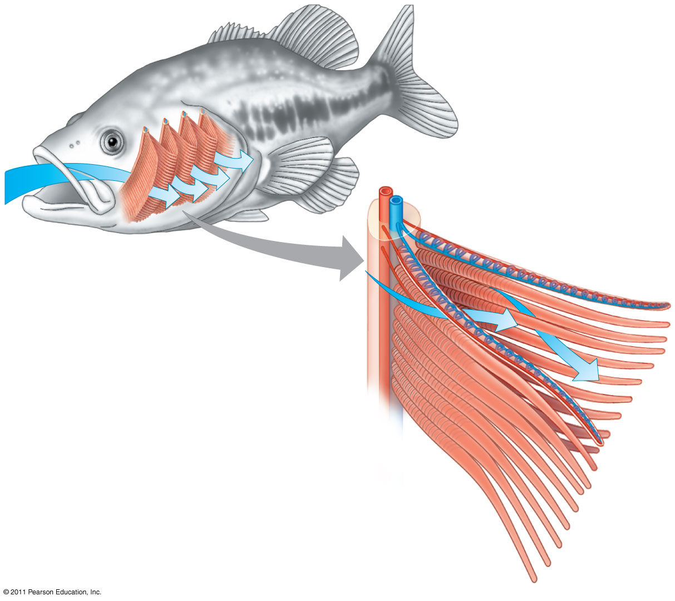
Figure 42.23a
Gill
arch
Blood
vessels
Gill arch
Water
flow
Operculum
Gill filaments
Notes:
Figure 42.23 The structure and function of fish gills.
Water flows past these structures where gas exchange can occur as blood flows through (cells have to be permeable to the gasses)

Slide 10
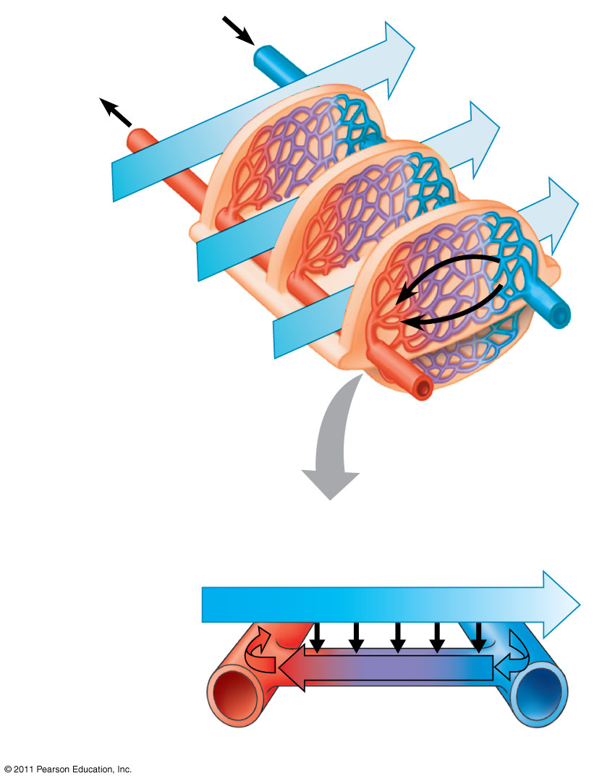
Figure 42.23b
O₂-poor blood
O₂-rich blood
Lamella
Water flow
Blood flow
Countercurrent exchange
P_{O} (mm Hg) in water
₂
150
120
90
60
30
Net diffu-
sion of O₂
140
110
80
50
20
P_{O} (mm Hg)
in blood
₂
Notes:
Figure 42.23 The structure and function of fish gills.

Slide 11
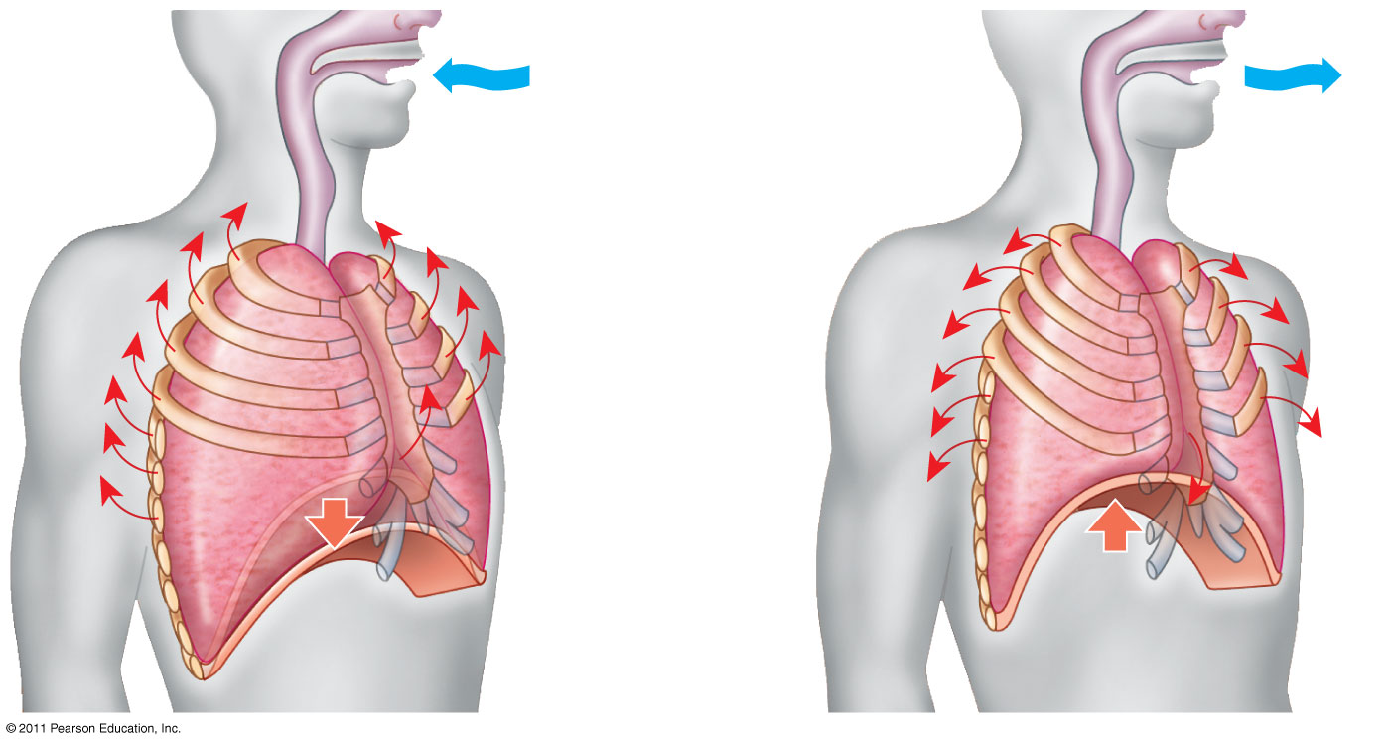
Figure 42.28
1
2
Rib cage
expands.
Air
inhaled.
Rib cage gets
smaller.
Air
exhaled.
Lung
Diaphragm
V₁ x P₁ = V₂ x P₂ P₂ = (V₁ x P₁)/V₂
Notes:
Figure 42.28 Negative pressure breathing.
Respiratory tissue are also very permeable to water so if the creature is terrestrial, they tend to either live near water/hide where it isn’t hot (salamander) or store the tissue inside and move air to the cells
In people, the driving force for the air to move is a pressure difference. See image (inhale by negative pressure when diaphragm goes down expanding the lungs)
This is called negative pressure ventilation b/c the negative pressure encourages air to enter the lungs

Slide 12
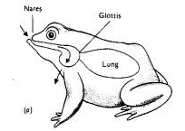
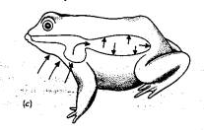
Positive pressure ventilation
Negative pressure
Positive pressure
Notes:
Pushing air into the lungs = positive pressure ventilation (moving air somewhere vs having air move in)

Slide 13
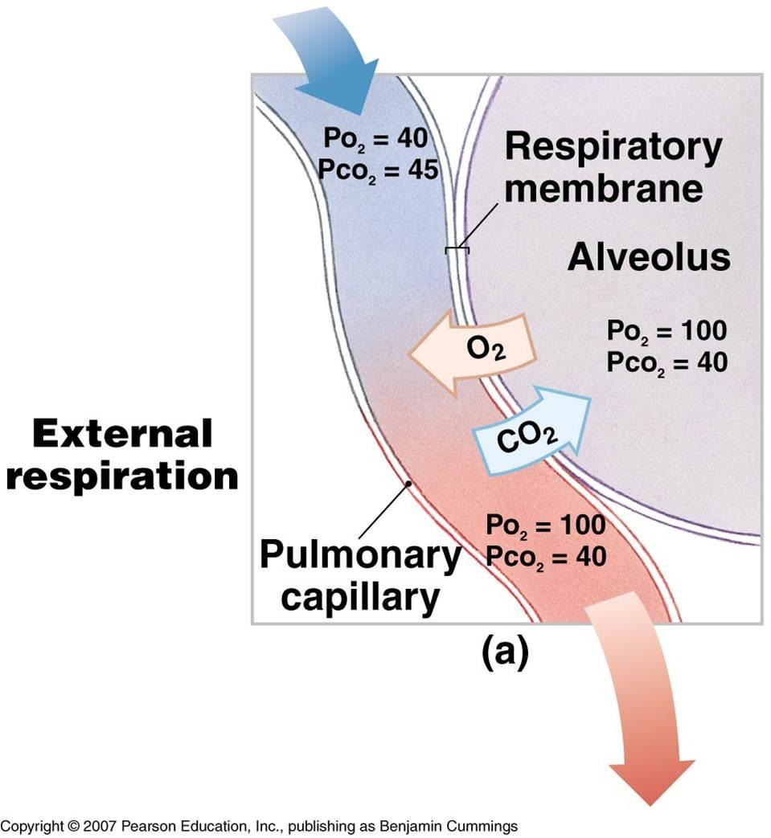
Step 2: Gas Exchange
By diffusion (pathway)
Driving force:
  partial pressure gradient

Slide 14
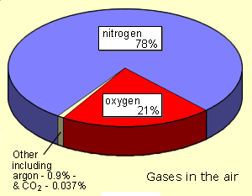
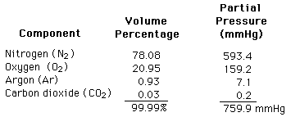
Partial pressure of gas A
= (total pressure) x (fractional contribution of gas A)
P_{A} = P_{tot} x %_{A}
Notes:
The partial pressure of CO2 is the driving force

Slide 15
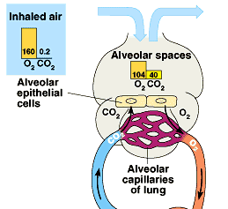
Air in the lung is mixed with “used” air and with water vapor
Notes:
Air in the lungs are humidified (because it is exposed to the wet surface of the alveoli)
The lungs can never be fully emptied (residual air)
When you inhale, the air becomes “diluted” by mixing with water vapor and the residual air (this is called alveolar air)

Slide 16
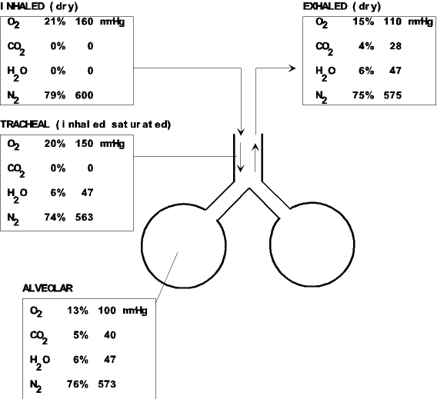
The result is that alveolar P_{O2} is less than atmospheric (inhaled) P_{O2}

Slide 17
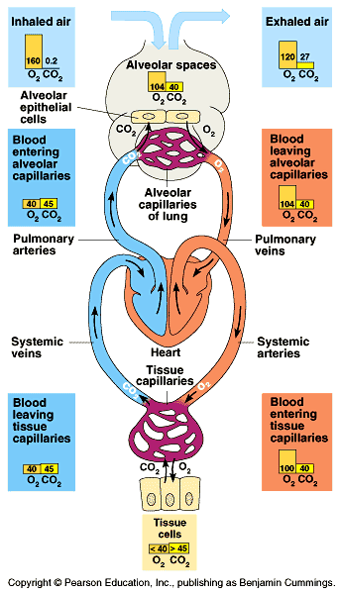
Tissues use O₂ and so the blood returning to the heart is depleted of O₂
Notes:
Blood coming to the lungs from the body has a lower O2 content as the O2 gets used by body cells as the blood traveled through it

Slide 18
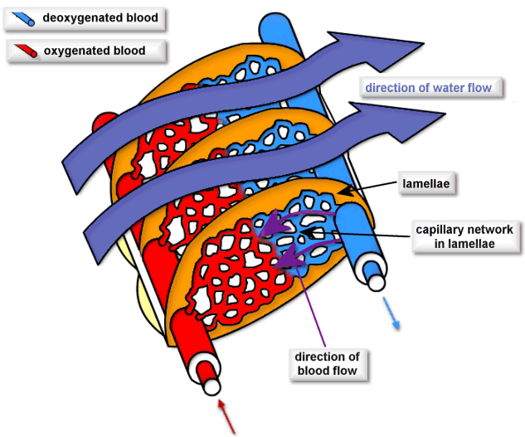
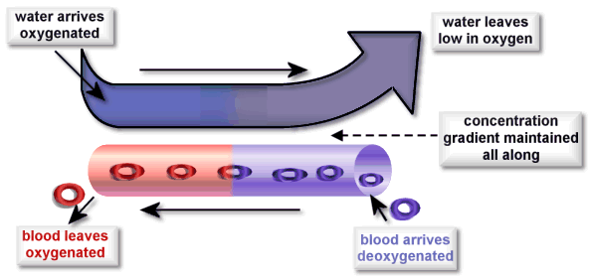
Gas partial pressures have the potential to equilibrate across the gas exchange surface
Notes:
In fish, that exchange occurs between liquid (external water) and liquid (internal blood)

Slide 19
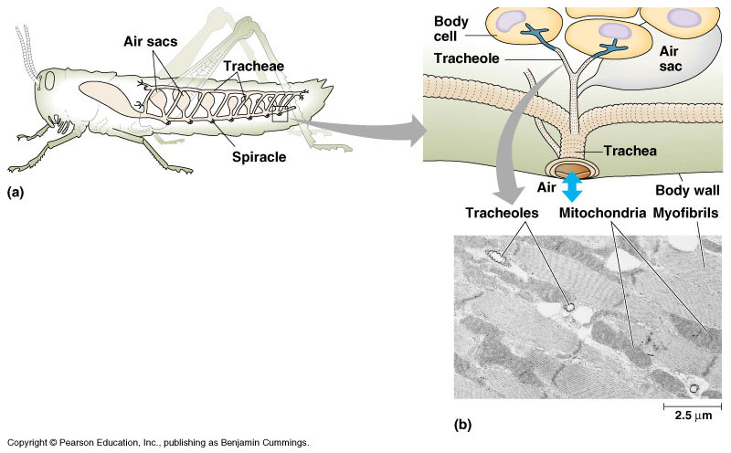
In insect tracheal systems, gas-filled tubes reach near to the cellular level
Notes:
They have tubes that connect to the environment that allows for O2 to diffuse from outside down to the cell level

Slide 20
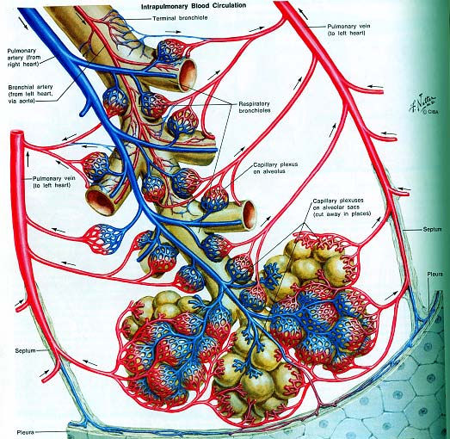
In mammalian (and many other) gas exchange systems, gas exchange is into a liquid (blood)

Slide 21
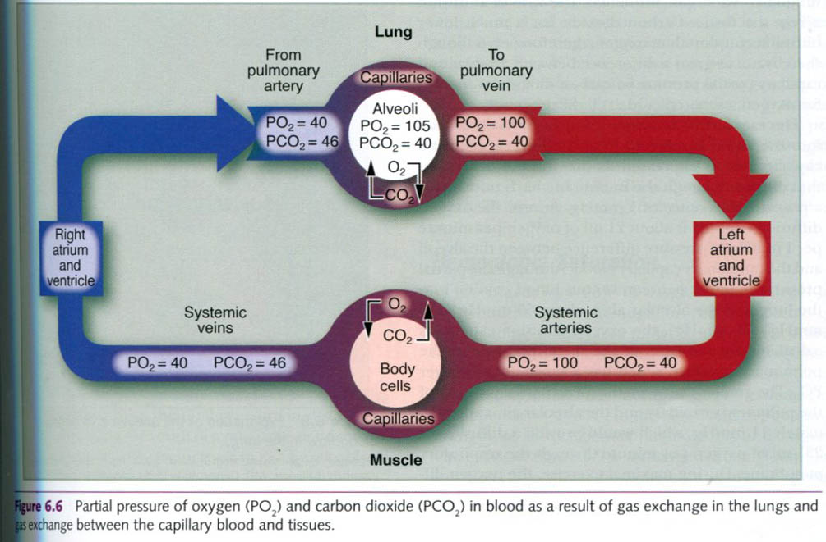
Gas partial pressures have the potential to equilibrate across the gas exchange surface

Slide 22
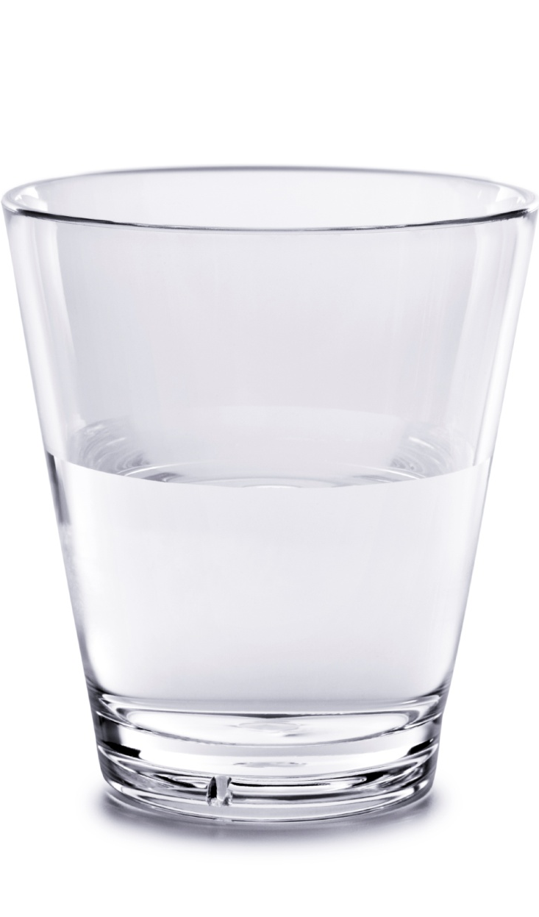
Air (in lungs)
PO₂ = 100 mm Hg
O₂ content = 130 ml O₂ per liter of air
This is equilibrium in the lungs
Water
PO₂ = 100 mm Hg
O₂ content = 3 ml O₂ per liter of water
Notes:
When gasses equilibrate between air and water, by definition they have the same partial pressure
Not very much O2 dissolves b/c O2 doesn’t dissolve in water well (there would be more if O2 was more soluble
This is similar to blood plasma - air

Slide 23
Dissolved O2 in plasma = 3ml/liter at 100 mmHg
Max cardiac output = 25L/min
Max delivery dissolved O2 from the heart = 3ml O2/l * 25 l/min = 75ml O2/min
Max metabolic rate ~ 3000ml O2/min
(partial pressure diffusion is not enough)

Slide 24
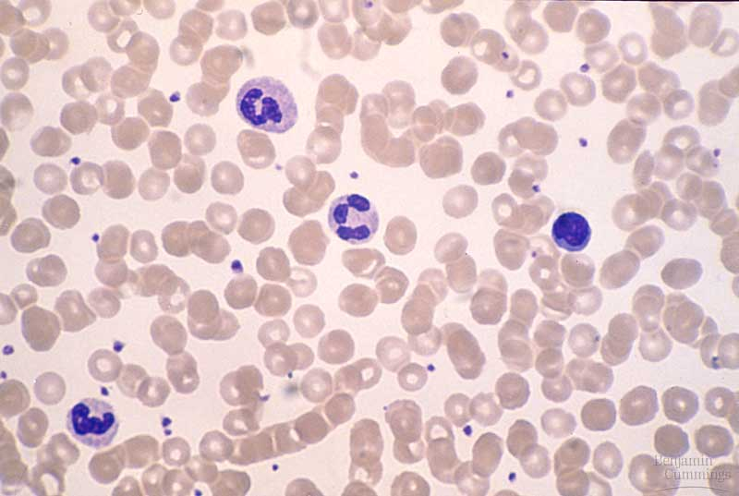
Red blood cells provide a supplemental means of carrying oxygen
Notes:
They are why enough O2 diffuses into blood

Slide 25
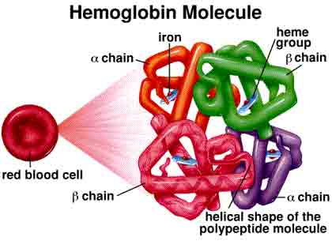
Notes:
Red blood cells works because of respitory pigments (varions metals that bind to oxygen and cause a different color to appear)

Slide 26
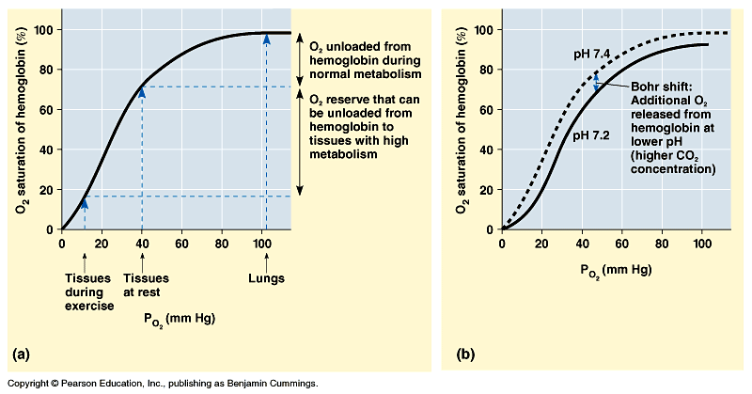
Oxygen dissociation curve for hemoglobin
Notes:
Depending on the O2 availability, red blood cells can bind up to 4 O2 molecules
b/c there are so many red blood cells, the graph has a smooth curve
O2 use at rest drops the pressure down to ≈40mmHg and the graph shows that the blood still has a lot of O2

Slide 27
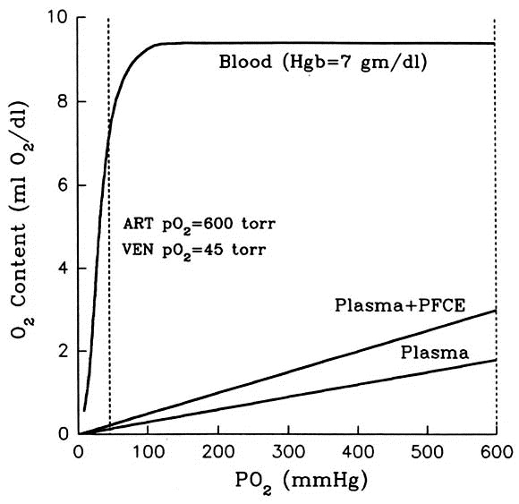
Hb greatly increases O₂ carrying capacity of blood
Notes:
Basically shows that the blood plasma cannot supply enough O2 to the body (much higher pressure of O2 but still nowhere near O2)

Slide 28
The Bohr shift

Slide 29
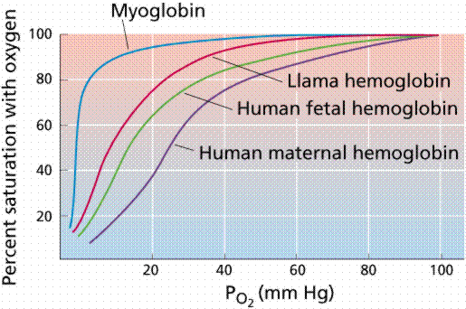

Slide 30
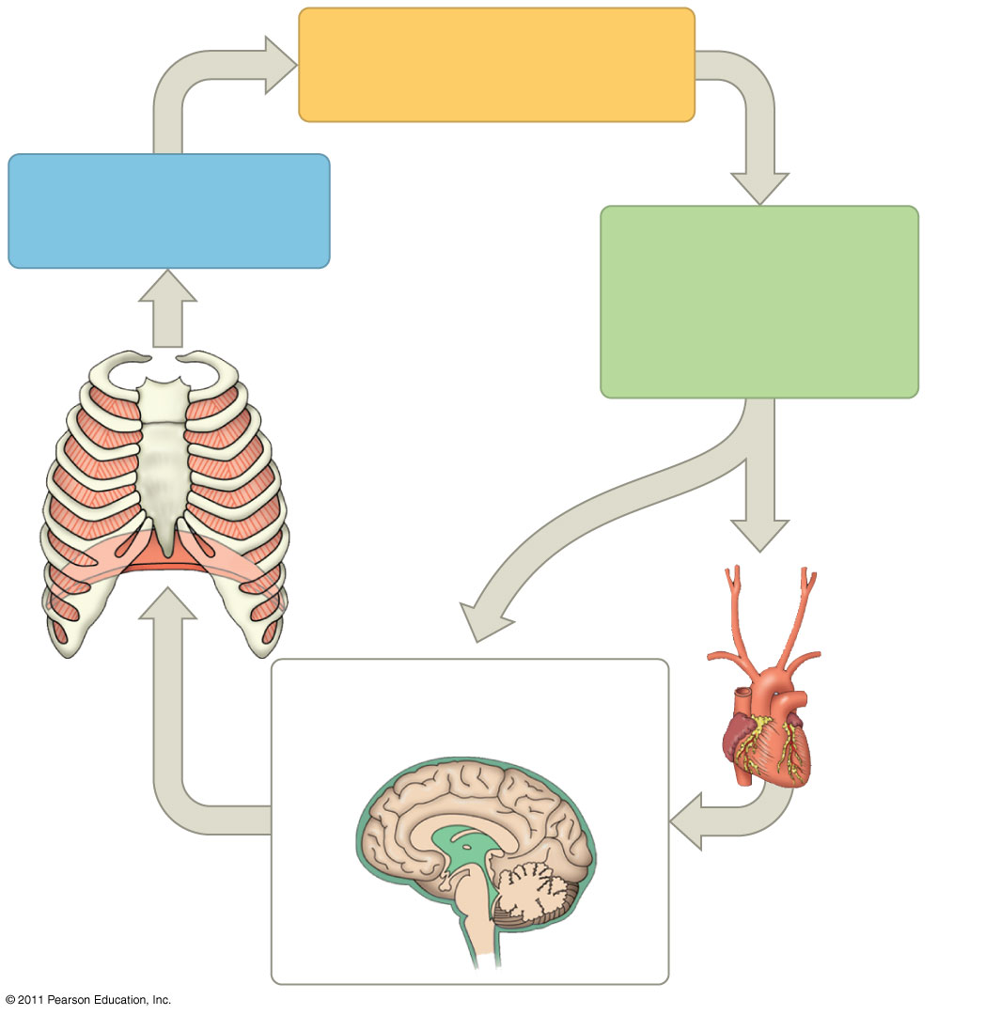
Figure 42.29
Homeostasis:
Blood pH of about 7.4
CO₂ level
decreases.
Stimulus:
Rising level of
CO₂ in tissues
lowers blood pH.
CO₂ + H₂O
HCO₃⁻ + H⁺
Response:
Rib muscles
and diaphragm
increase rate
and depth of
ventilation.
Carbonic anhydrase
Carotid
arteries
Sensor/control center:
Aorta
Cerebrospinal fluid
Medulla
oblongata
Notes:
Figure 42.29 Homeostatic control of breathing.
CO2 is what gets regulated, not O2 b/c the body greatly impacted by pH

Slide 31
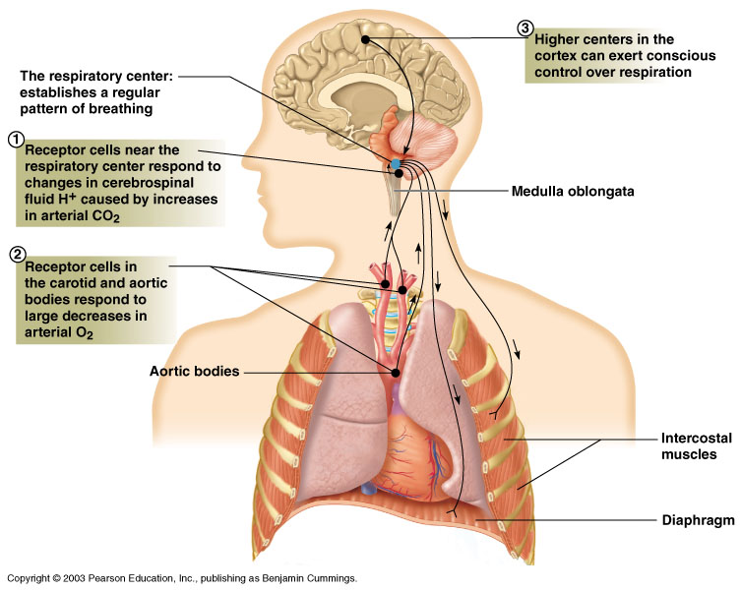
Chemoreceptors communicate with respiratory control centers in the brain
Notes:
Brainstem sets the rythem of breathing which gets modified based on the sensors (which are usually by the brain stem although there are some supplemental sensors by the heart)
The output is the brain controlling the contraction of the diaphragm that controls breathing

Slide 32
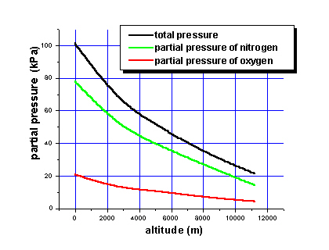

Slide 33
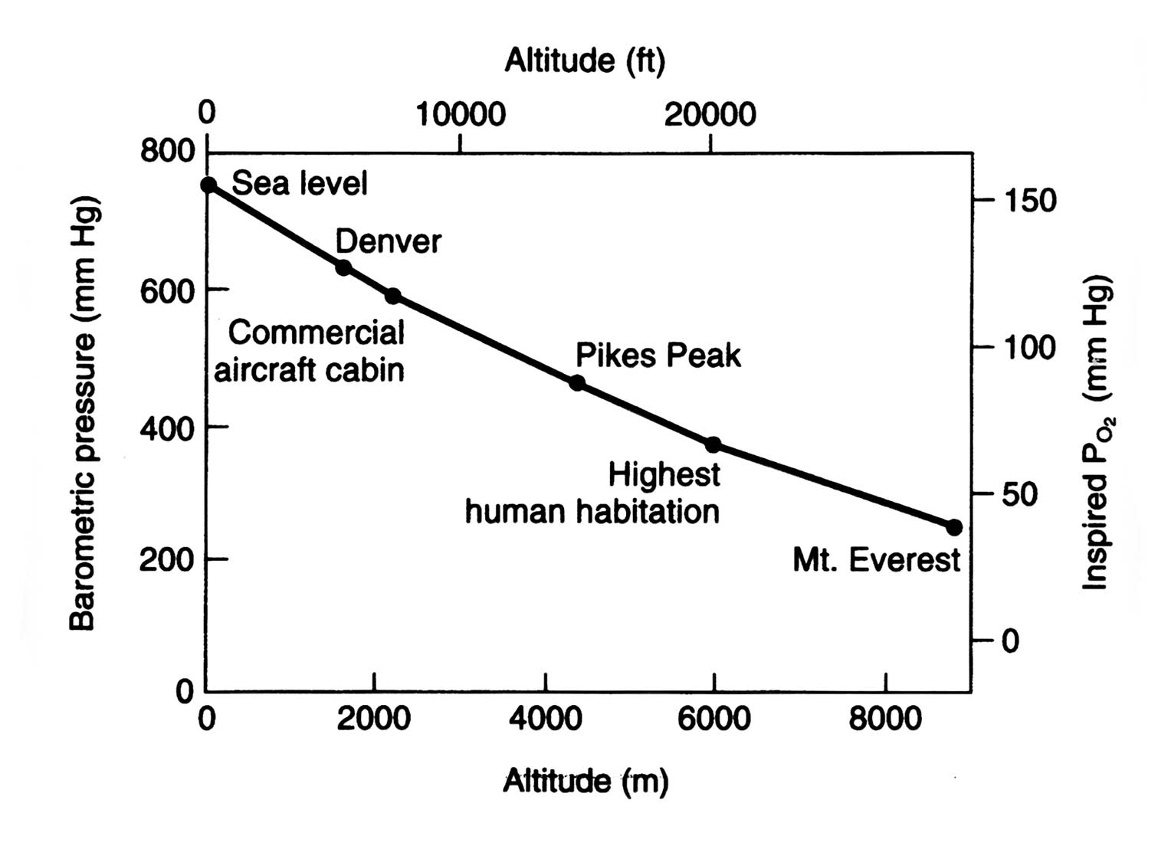

Slide 34
Respiration at high altitude
Altitude (m) | P_{atm} (mm Hg) | P_{O2}, atm | P_{O2}, alv. | % O2 sat. of blood
0 | 760 | 160 | 105 | 98
1000 | 660 | 139 | 90 | 97
3000 | 520 | 109 | 70 | 90
5000 | 400 | 84 | 52 | 89
Note: Atmospheric PCO2 is virtually unaffected because it occurs at such a low %

